Slide 1
Launchpad Lecture -22
Data Structures
Graphs
Notes:
File Handling
Linked list code

Slide 2
Graphs

Slide 3
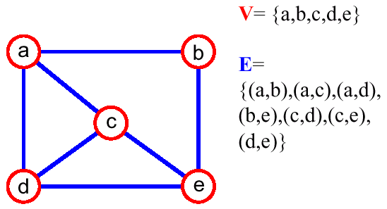
Graphs
Notes:
Flight network road network

Slide 4
Terminology
Adjacent Vertices
Degree
Path
Connected Graph
Subgraph
Connected Components
Tree
Forest
Spanning Tree

Slide 5
Number of edges
Complete Graph
Connected Graph
Tree

Slide 6
How to implement Graph?
Edge List
Adjacency lists
Adjacency matrix

Slide 7
Searching in a Graph

Slide 8
How to Search through a Graph?
Breadth First Search
Depth First Search

Slide 9
Problems
Implement isConnected for our graph
Return all the connected components of the graph
Snakes and Ladders Problem.

Slide 10
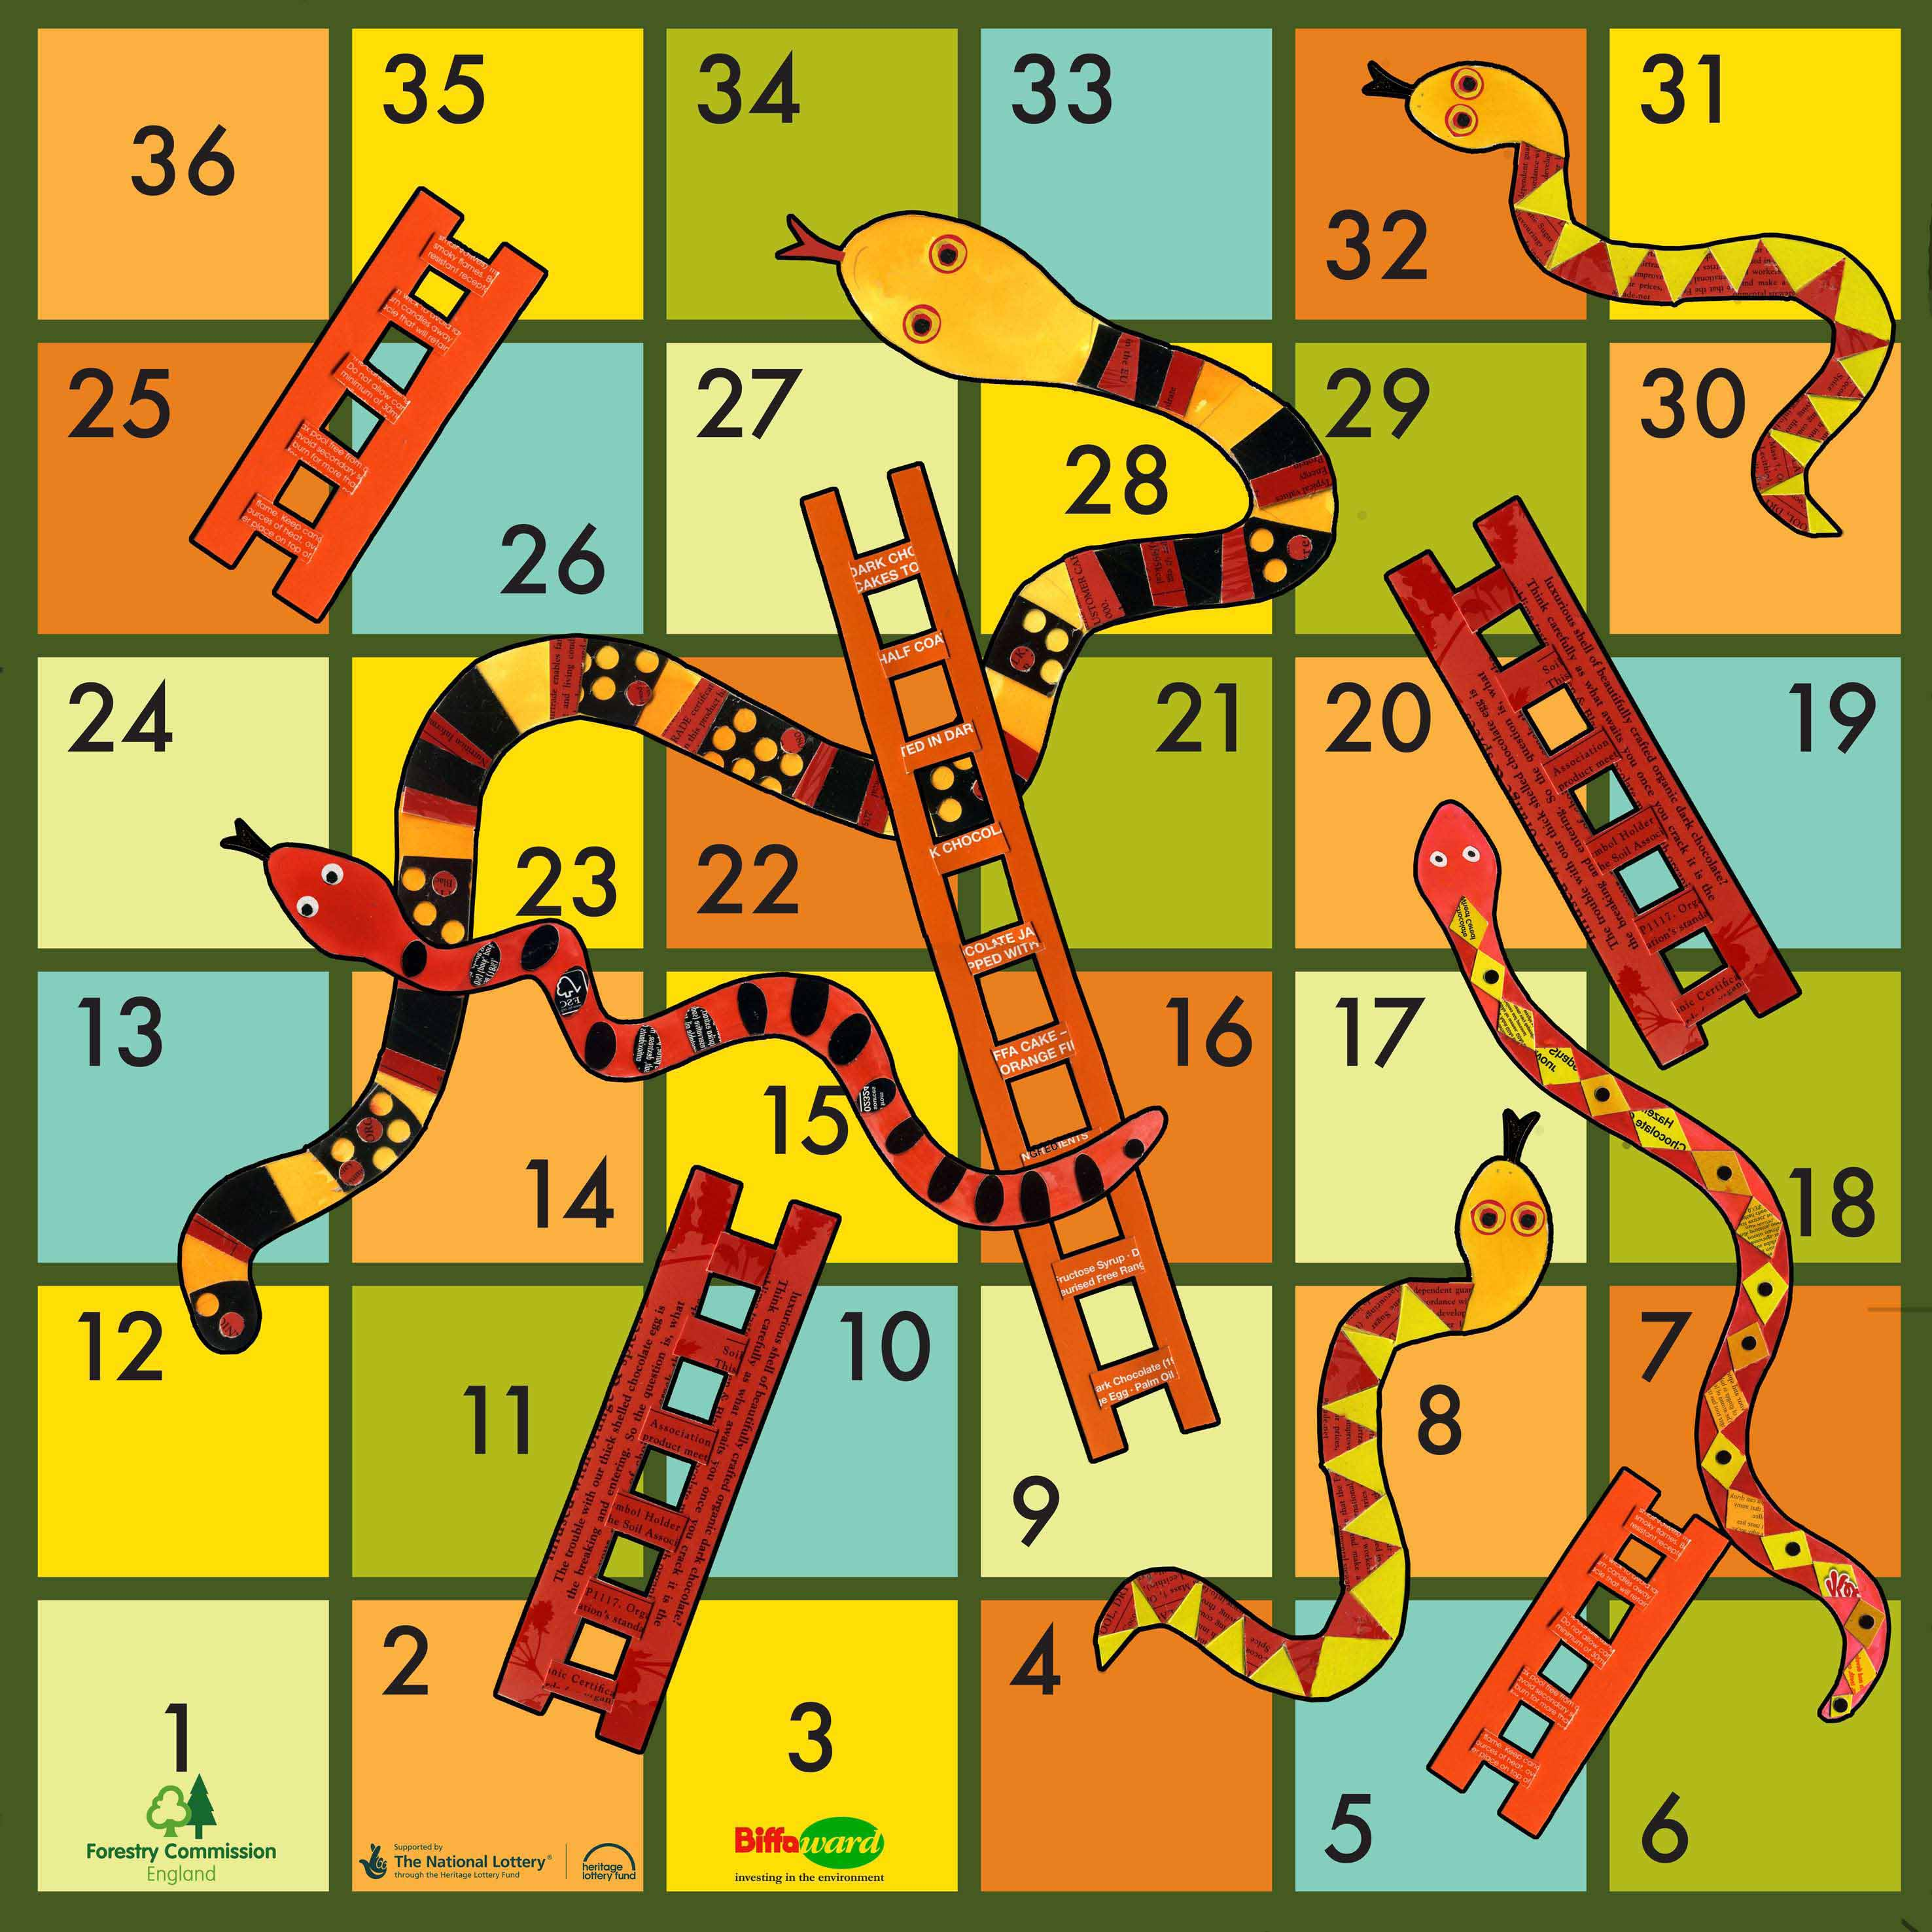

Slide 11
Some more Graph variations
Directed Graphs
Weighted Graphs
Shortest Path on Weighted Graph-
Dijkstra’s Algorithm

Slide 12
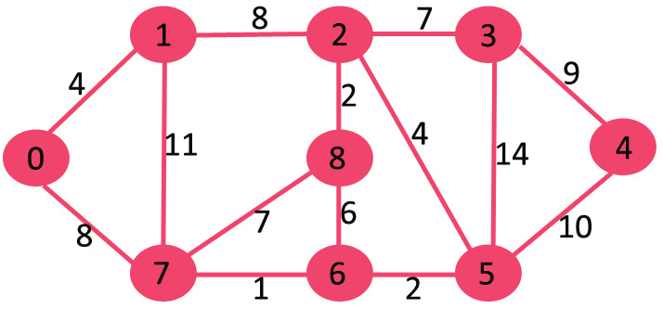

Slide 13

Thank You!
Prateek Narang
Prateek@codingblocks.com

